Slide 1
CMSC204
Kartchner
V(StateGraph) = {Oregon, Alaska, Texas, Hawaii, Vermont, NewYork, California}
E(StateGraph) = {(Alaska, Oregon), (Hawaii, Alaska), (Hawaii, Texas), (Texas, Hawaii), (Hawaii, California), (Hawaii, New York), (Texas, Vermont), (Vermont, California), (Vermont, Alaska)}
1. Draw the StateGraph
AL
OR
NY
VT
CA
HI
TX
{Oregon, Alaska, Texas, Hawaii, Vermont, New York, California}
{(Alaska, Oregon), (Hawaii, Alaska), (Hawaii, Texas), (Texas, Hawaii), (Hawaii, California), (Hawaii, New York), (Texas, Vermont), (Vermont, California), (Vermont, Alaska)}
No
Yes
Texas

Slide 2
a. Show the adjacency matrix that would describe the edges in the graph. Store the vertices in alphabetical order
States
AL CA HI NY OR TX VT
Alaska
California
Hawaii
New York
Oregon
Texas
Vermont
0 0 0 0 1 0 0
0 0 0 0 0 0 0
1 1 0 1 0 1 0
0 0 0 0 0 0 0
0 0 0 0 0 0 0
0 0 1 0 0 0 1
1 1 0 0 0 0 0
3. b. Show the adjacency lists
that would describe the edges in the graph
Alaska
California
Hawaii
New York
Oregon
Texas
Vermont
OR
AL
CA
NY
TX
VT
HI
AL
CA

Slide 3
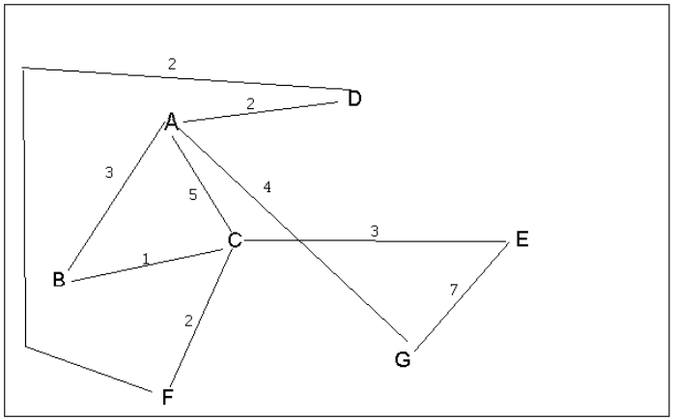
4 a. Which of the following lists the graph nodes in depth first order beginning with E?
A) E, G, F, C, D, B, A
B) G, A, E, C, B, F, D
C) E, G, A, D, F, C, B
D) E, C, F, B, A, D, G
4 b. Which of the following lists the graph nodes in breadth first order beginning at F?
A) F, C, D, A, B, E, G
B) F, D, C, A, B, C, G
C) F, C, D, B, G, A, E
D) a, b, and c are all breadth first traversals

Slide 4
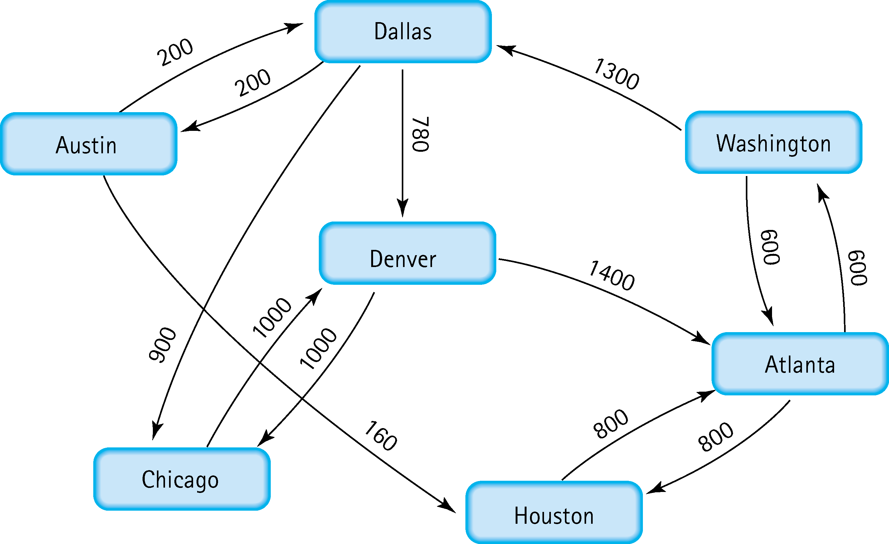
5. Find the shortest distance from Atlanta to every other city
Atlanta – Austin
Atlanta – Chicago
Atlanta – Dallas
Atlanta – Denver
Atlanta – Houston
Atlanta – Washington
2100
2800
1900
2680
800
600

Slide 5
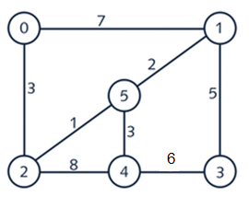
6. Find the minimal spanning tree using Prim’s algorithm. Use
0 as the source vertex . Show the steps.
Weight
0
2
5
5
1
2
5
1
4
3
3
1
2
3
5
0
1
5
2
4
3
0 1 2 3 4 5
V(T) = {0}
E(T) = { }
N(T) = {1, 2, 3, 4, 5}
0
1
2
3
4
5
0 0 1 0 0 0
0 0 0 1 0 0
0 0 0 0 0 1
0 0 0 0 0 0
2) V(T) = {0, 2}
E(T) = {(0, 2)}
N(T) = {1, 3, 4, 5}
0 0 0 0 0 0
0 1 0 0 1 0
Vertex (0) is added
Edges [7] and [3] are considered, edge [3] and vertex (2) will be added
Edges [7], [1], and [8] are considered, edge [1] and vortex (5) will be added
Edges [8], [2], and [3] are considered, edge [2] and vortex (1) will be added
Edges [8], [3], and [5] are considered, edge [3] and vortex (4) will be added
Edges [6] and [5] are considered, edge [5] and vortex (3) will be added
3) V(T) = {0, 2, 5}
E(T) = {(0, 2) (2, 5)}
N(T) = {1, 3, 4}
4) V(T) = {0, 1, 2, 5}
E(T) = {(0, 2) (2, 5) (5, 1)}
N(T) = {3, 4}
5) V(T) = {0, 1, 2, 4, 5}
E(T) = {(0, 2) (2, 5) (5, 1) (5, 4)}
N(T) = {3}
5) V(T) = {0, 1, 2, 3, 4, 5}
E(T) = {(0, 2) (2, 5) (5, 1) (5, 4) (1, 3)}
N(T) = { }

Slide 6
7. Find the minimal spanning tree using Kruskal’s algorithm.
Show the weights in order and the steps.
List all edges and weights
Put them all in numerical order by weight
Add edges to MST until every vertex connects to every other
Don’t add connection if both vertices are already connected
If one vertex is not in a set of vertices, add an edge
Edge
Weight
Edge
Weight
0 - 1
0 - 2
1 - 3
1 - 5
2 - 4
2 - 5
3 - 4
4 - 5
7
3
5
2
8
1
6
3
2 - 5
1 - 5
0 - 2
4 - 5
1 - 3
3 - 4
0 - 1
2 - 4
1
2
3
3
5
6
7
8
0
1
5
2
4
3
0
1
0
1
0
1
0
1
5
5
5
5
2
4
3
2
4
3
2
4
3
2
4
3

Slide 7
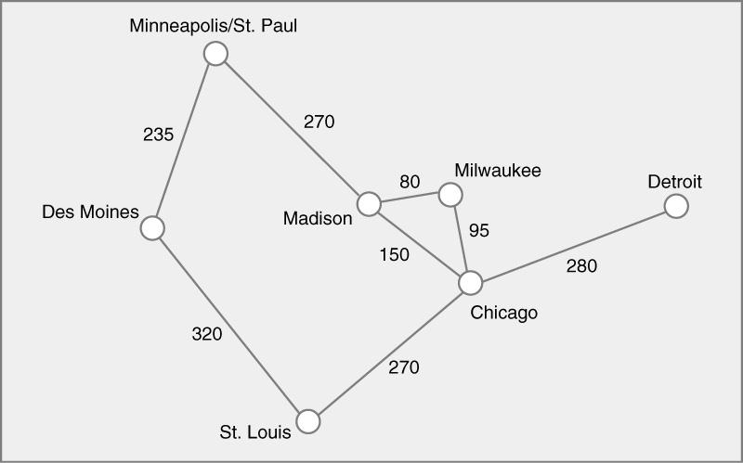
8. Find the minimal spanning tree using the algorithm you prefer. Use
Minneapolis/St. Paul as the source vertex
Edge
Weight
Edge
Weight
V(T) = {0, 1, 2, 3, 4, 5, 6}
E(T) = {(0, 1) (0, 3) (3, 4)
(4, 5) (5, 2) (5, 6)}
0 - 1
0 - 3
1 - 2
2 - 5
3 - 4
3 - 5
4 - 5
5 - 6
235
270
320
270
80
150
95
280
3 - 4
4 - 5
3 - 5
0 - 1
0 - 3
2 - 5
5 - 6
1 - 2
80
95
150
235
270
270
280
320

Slide 8
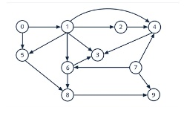
9. List the nodes of the graph in a breadth first topological ordering. Show the
steps using arrays predCount, topologicalOrder and a queue
[0] [1] [2] [3] [4] [5] [6] [7] [8] [9]
predCount₀ Topological Order
Queue
predCount₁
predCount₂
predCount₃
predCount₄
0[ [1[ [1[ [3[ [3[ [2[ [2[ [0[ [2[ [2
0[ [7[ [1[ [2[ [5[ [6[ [4[ [8[ [3[ [9
0[ [7[ [1[ [2[ [5[ [6[ [4[ [8[ [3[ [9
0[ [0[ [1[ [3[ [2[ [1[ [1[ [0[ [2[ [1
0[ [7[ [0[ [2[ [1[ [0[ [0[ [8[ [2[ [1
0[ [7[ [1[ [1[ [0[ [6[ [4[ [8[ [0[ [1
0[ [0[ [0[ [0[ [0[ [0[ [0[ [0[ [0[ [0
1 > 7 > 1 > 2 > 5 > 6 > 4 > 8 > 3 > 9

Slide 9
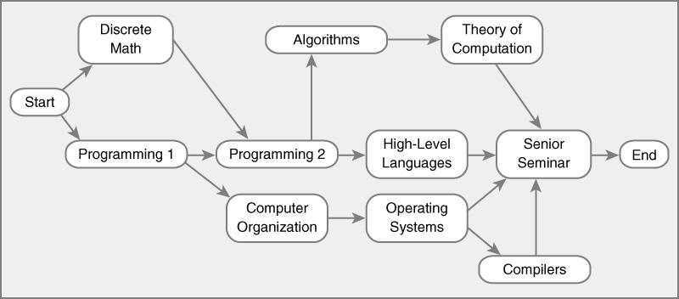
10. List the nodes of the graph in a breadth first topological ordering.
A
S
DM
TC
HLL
E
P1
P2
SS
CO
OS
C
Start > Decrete Math > Programming 1 > Programming 2 > Computer Organization > Algorithms > Operating Systems > High Level Language > Theory Of Computation > Compilers > Senior Seminar > End
[0] [1] [2] [3] [4] [5] [6] [7] [8] [9]
predCount₀ Topological Order
Queue
predCount₁
predCount₂
predCount₃
predCount₄
predCount₅
0[ [1[ [1[ [2[ [1[ [1[ [1[ [1[ [1[ [4 [ 1[[1
S
DM
P1
P2
CO
A
OS
HLL
TC
C
SS
E
S
DM P1
P2
CO
A OS HLL
TC C
SS
E
0[ [0[ [0[ [2[ [1[ [1[ [1[ [1[ [2[ [4 1[ [1
0[ [7[ [0[ [0[ [0[ [1[ [1[ [1[ [1[ [4 1[ [1
0[ [7[ [1[ [0[ [0[ [0[ [0[ [0[ [1[ [4 1[ [1
0[ [7[ [1[ [0[ [0[ [0[ [0[ [0[ [0[ [2 0[ [1
0[ [0[ [0[ [2[ [1[ [1[ [1[ [1[ [2[ [0 1[ [1

